Slide 1

REVIEW JURNAL “SISTEM PENDUKUNG KEPUTUSAN PEMILIHAN LAPTOP DENGAN MENGGUNAKAN METODE TOPSIS”
Disusun oleh:
Rama Pramudya Wibisana 2022320019

Slide 2
KRITERIA DAN PERTIMBANGAN
KRITERIA:
C1 = Harga
C2 = RAM
C3 = Hardisk
C4 = Prosesor
C5 = Ukuran Layar
C6 = VGA
C7 = Baterai
C8 = Berat Laptop
C9 = Garansi
PERTIMBANGAN:
S1=Acer
S2=HP
S3=Asus
S4=Lenovo

Slide 3
TABEL 1: SPESIFIKASI LAPTOP
Merk | Harga | RAM | Hardisk | Prosesor | Uk, Layar | VGA | Baterai | Berat | Garansi
Acer | 7.159.000 | 6 GB | 1 TB | i5 | 14 | 2 GB | 12 | 2,2 kg | Distributor
HP | 4.349.000 | 4 GB | 1 TB | A9 | 14 | 2 GB | 6 | 1,5 kg | Resmi
Asus | 8.599.000 | 8 GB | 1 TB | i5 | 14 | 2 GB | 6 | 1,6 kg | Resmi
Lenovo | 7.259.000 | 12 GB | 1 TB | i5 | 14 | 2 GB | 4 | 2,3 kg | Resmi
TABEL 2: BOBOT TIAP KRITERIA
 | C1 | C2 | C3 | C4 | C5 | C6 | C7 | C8 | C9
Bobot | 5 | 5 | 4 | 5 | 3 | 4 | 4 | 3 | 4

Slide 4
TABEL 3: NILAI SETIAP ALTERNATIF PADA SETIAP KRITERIA DAN SUB KRITERIA
Kriteria | Sub Kriteria | Nilai
Harga | >15 Juta 8 Juta-15 Juta 5 Juta-8 Juta 3 Juta-5 Juta <3 Juta | 1 2 3 4 5
RAM | 4 GB 6 GB 8 GB 12 GB >16 GB | 1 2 3 4 5
Hardisk | <=250 GB 320 GB 500 GB 1 TB >1 TB | 1 2 3 4 5
Prosesor | Pentium Celeron Core i3 Core i5 Core i7 | 1 2 3 4 5
Kriteria | Sub Kriteria | Nilai
Ukuran Layar | <13 inci 13 inci-14,9 inci 15 inci-15,6 inci 15,6 inci-17 inci >17 inci | 1 2 3 4 5
VGA | 2 GB 4 GB 6 GB 8 GB >8 GB | 1 2 3 4 5
Baterai | <3 Jam 3 Jam-6 Jam 6 Jam-9 Jam 9 Jam-12 Jam >=12 | 1 2 3 4 5
Berat Laptop | <1,5 kg 1,5 kg-2 kg 2 kg-3 kg 3 kg-4 kg >4 kg | 1 2 3 4 5
Kriteria | Sub Kriteria | Nilai
Garansi | Toko Distributor Resmi | 1 3 5

Slide 5
TABEL 4: MEMBUAT KEPUTUSAN TERNORMALISASI
 | C1 | C2 | C3 | C4 | C5 | C6 | C7 | C8 | C9
S1 | 3 | 2 | 4 | 4 | 2 | 1 | 4 | 3 | 3
S2 | 4 | 1 | 4 | 4 | 2 | 1 | 3 | 2 | 5
S3 | 2 | 3 | 4 | 4 | 2 | 1 | 3 | 2 | 5
S4 | 3 | 1 | 4 | 4 | 2 | 1 | 2 | 3 | 5
Hasil Pangkat Perkriteria | 38 | 15 | 64 | 64 | 16 | 4 | 38 | 26 | 84
Akar Hasil Pangkat Perkrite ria | 6,1644 | 3,8730 | 8,0000 | 8,0000 | 4,0000 | 2,0000 | 6,1644 | 5,0990 | 9,1652

Slide 6

RUMUS MENORMALISASIKAN
R1.1 = 3:6,1644 = 0,4867
R1.2 = 4:6,1644 = 0,6489
R1.3 = 2:6,1644 = 0,3244
R1.4 = 3:6,1644 = 0,4867
R2.1=2:3,8730 = 0,5164
R2.2=1:3,8730 = 0,2582
R2.3=3:3,8730 = 0,7746
R2.4=1:3,8730 = 0,2582
R3.1=4:8,0000 = 0,5000
R3.2=4:8,0000 = 0,5000
R3.3=4:8,0000 = 0,5000
R3.4=4:8,0000 = 0,5000
R4.1=3:8,0000 = 0,5000
R4.2=4:8,0000 = 0,5000
R4.3=5:8,0000 = 0,5000
R4.4=4:8,0000 = 0,5000
R5.1=2:4,0000 = 0,2182
R5.2=2:4,0000 = 0,2182
R5.3=2:4,0000 = 0,2182
R5.4=2:4,0000 = 0,2182
R7.1=4:6,1644 = 0,6489
R7.2=3:6,1644 = 0,4867
R7.3=3:6,1644 = 0,4867
R7.4=2:6,1644 = 0,3244
R7.1=4:6,1644 = 0,6489
R7.2=3:6,1644 = 0,4867
R7.3=3:6,1644 = 0,4867
R7.4=2:6,1644 = 0,3244
R8.1=3:5,0909 = 0,5883
R8.2=2:5,0909 = 0,3922
R8.3=2:5,0909 = 0,3922
R8.4=2:5,0909 = 0,5883
R9.1=3:9,1652 = 0,3273
R9.2=5:9,1652 = 0,5455
R9.3=5:9,1652 = 0,5455
R9.4=5:9,1652 = 0,5455

Slide 7
TABEL 5: DATA NORMALISASI
 | C1 | C2 | C3 | C4 | C5 | C6 | C7 | C8 | C9
S1 | 0,4867 | 0,5164 | 0,5000 | 0,5000 | 0,2182 | 0,5000 | 0,6489 | 0,5883 | 0,3273
S2 | 0,6489 | 0,2582 | 0,5000 | 0,5000 | 0,2182 | 0,5000 | 0,4867 | 0,3922 | 0,5455
S3 | 0,3244 | 0,7746 | 0,5000 | 0,5000 | 0,2182 | 0,5000 | 0,4867 | 0,3922 | 0,5455
S4 | 0,4867 | 0,2582 | 0,5000 | 0,5000 | 0,2182 | 0,5000 | 0,3244 | 0,5883 | 0,5455
TABEL 6: NORMALISASI BERBOBOT
(DATA NORMALISASI) X (BOBOT KRITERIA)
 | C1 | C2 | C3 | C4 | C5 | C6 | C7 | C8 | C9
S1 | 2,4333 | 2,5820 | 2,0000 | 2,5000 | 0,6547 | 2,0000 | 2,5955 | 1,7650 | 1,3093
S2 | 3,2444 | 1,2910 | 2,0000 | 2,5000 | 0,6547 | 2,0000 | 1,9467 | 1,1767 | 2,1822
S3 | 1,6222 | 3,8730 | 2,0000 | 2,5000 | 0,6547 | 2,0000 | 1,9467 | 1,1767 | 2,1822
S4 | 2,4333 | 1,2910 | 2,0000 | 2,5000 | 0,6547 | 2,0000 | 1,2978 | 1,7650 | 2,1822

Slide 8
TABEL 7: MAX & MIN DARI NORMALISASI BERBOBOT
 | C1 | C2 | C3 | C4 | C5 | C6 | C7 | C8 | C9
S1 | 2,4333 | 2,5820 | 2,0000 | 2,5000 | 0,6547 | 2,0000 | 2,5955 | 1,7650 | 1,3093
S2 | 3,2444 | 1,2910 | 2,0000 | 2,5000 | 0,6547 | 2,0000 | 1,9467 | 1,1767 | 2,1822
S3 | 1,6222 | 3,8730 | 2,0000 | 2,5000 | 0,6547 | 2,0000 | 1,9467 | 1,1767 | 2,1822
S4 | 2,4333 | 1,2910 | 2,0000 | 2,5000 | 0,6547 | 2,0000 | 1,2978 | 1,7650 | 2,1822
Max | 3,2444 | 3,8730 | 2,0000 | 2,5000 | 0,6547 | 2,0000 | 2,5955 | 1,7650 | 2,1822
Min | 1,6222 | 1,2910 | 2,0000 | 2,5000 | 0,6547 | 2,0000 | 1,2978 | 1,1767 | 1,3093
Jika kriteria bersifat Benefit (makin besar makin baik) maka D+ = max dan D- = min.
Jika kriteria bersifat Cost (makin kecil makin baik) maka D+ = min dan D- = max.
Dalam kasus ini semua telah di grade maka semua sifatnya adalah Benefit.

Slide 9
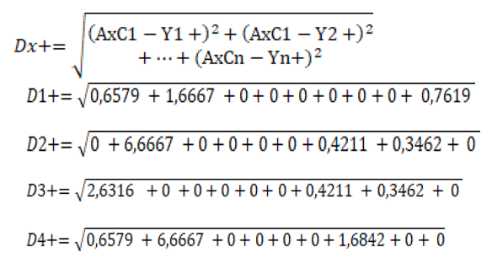
MENCARI D+
TABEL 8: HASIL PERHITUNGAN D+
D1+ | 1,7568
D2+ | 2,7265
D3+ | 1,8436
D4+ | 3,0015

Slide 10
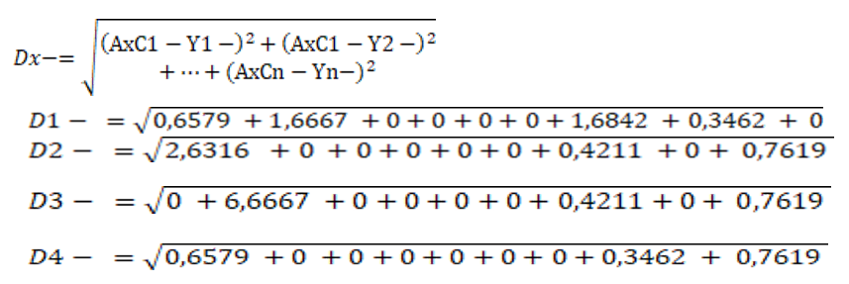
MENCARI D-
TABEL 9: HASIL PERHITUNGAN D-
D1- | 2,0868
D2- | 1,9531
D3- | 2,8017
D4- | 1,3289

Slide 11
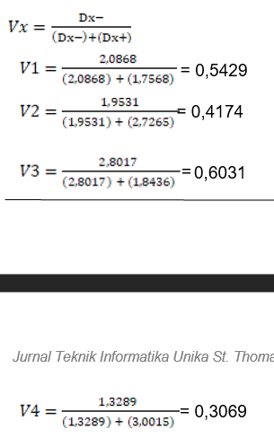
MENCARI V / HASIL
TABEL 10: PREFERENSI DAN RANGKING ALTERNATIF
Alternatif | Preferensi | Rangking
S1 (Acer) | 0,5429 | 2
S2 (HP) | 0,4174 | 3
S3 (Asus) | 0,6031 | 1
S4 (Lenovo) | 0,3069 | 4
Hasil perhitungan memperoleh keputusan bahwa laptop dengan merk Asus merupakan laptop yang paling direkomendasikan karena memiliki nilai terbaik dibandingkan dengan merk lain.

Slide 12
TERIMA KASIH

